Slide 1
Python Collections (Arrays)
There are four collection data types in the Python programming language:
List is a collection which is ordered and changeable. Allows duplicate members.
Tuple is a collection which is ordered and unchangeable. Allows duplicate members.
Set is a collection which is unordered, unchangeable*, and unindexed. No duplicate members.
Dictionary is a collection which is ordered** and changeable. No duplicate members.

Slide 2
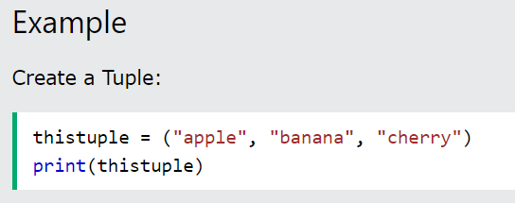
Python Tuples
Tuple
Tuples are used to store multiple items in a single variable.
Tuple is one of 4 built-in data types in Python used to store collections of data, the other 3 are List, Set, and Dictionary, all with different qualities and usage.
A tuple is a collection which is ordered and unchangeable.
Tuples are written with round brackets.

Slide 3
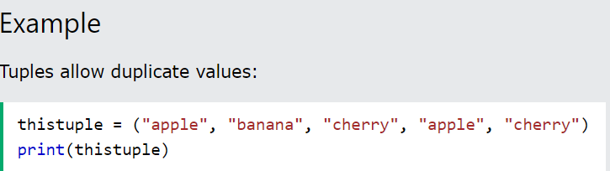
Tuple Items
Tuple items are ordered, unchangeable, and allow duplicate values.
Tuple items are indexed, the first item has index [0], the second item has index [1] etc.
Ordered
When we say that tuples are ordered, it means that the items have a defined order, and that order will not change.
Unchangeable
Tuples are unchangeable, meaning that we cannot change, add or remove items after the tuple has been created.
Allow Duplicates
Since tuples are indexed, they can have items with the same value:

Slide 4
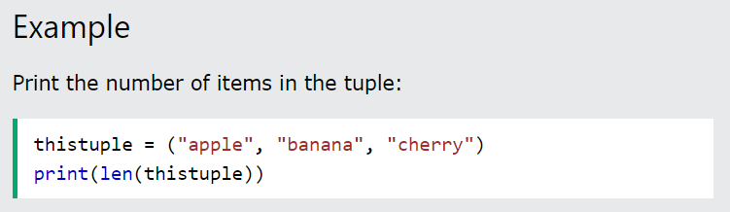
Tuple Length
To determine how many items a tuple has, use the len() function

Slide 5

Tuple Items - Data Types
Tuple items can be of any data type:
Example
String, int and boolean data types:
A tuple can contain different data types:
Example
A tuple with strings, integers and boolean values:
tuple1 = ("abc", 34, True, 40, "male")

Slide 6
The tuple() Constructor
It is also possible to use the tuple() constructor to make a tuple.
Example
Using the tuple() method to make a tuple:
thistuple = tuple(("apple", "banana", "cherry")) # note the double round-brackets print(thistuple)

Slide 7
Python - Access Tuple Items
Access Tuple Items
You can access tuple items by referring to the index number, inside square brackets:
Example
Print the second item in the tuple:
thistuple = ("apple", "banana", "cherry") print(thistuple[1])
Note: The first item has index 0.
Negative Indexing
Negative indexing means start from the end.
-1 refers to the last item, -2 refers to the second last item etc.
Example
Print the last item of the tuple:
thistuple = ("apple", "banana", "cherry") print(thistuple[-1])

Slide 8
Range of Indexes
You can specify a range of indexes by specifying where to start and where to end the range.
When specifying a range, the return value will be a new tuple with the specified items.
Example
Return the third, fourth, and fifth item:
thistuple = ("apple", "banana", "cherry", "orange", "kiwi", "melon", "mango") print(thistuple[2:5])

Slide 9
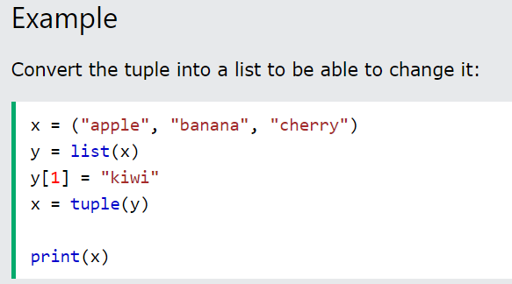
Python - Update Tuples
❮
Tuples are unchangeable, meaning that you cannot change, add, or remove items once the tuple is created.
But there are some workarounds.
Change Tuple Values
Once a tuple is created, you cannot change its values. Tuples are unchangeable, or immutable as it also is called.
But there is a workaround. You can convert the tuple into a list, change the list, and convert the list back into a tuple.

Slide 10
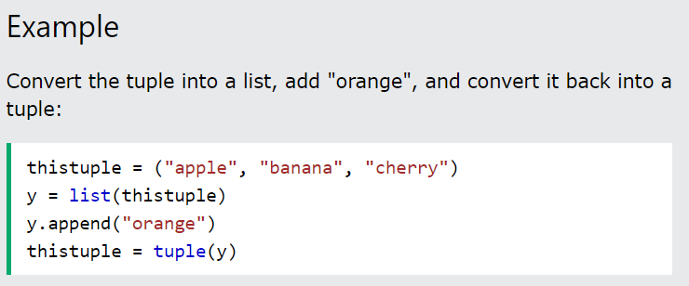
Add Items
Since tuples are immutable, they do not have a build-in append() method, but there are other ways to add items to a tuple.
1. Convert into a list: Just like the workaround for changing a tuple, you can convert it into a list, add your item(s), and convert it back into a tuple.

Slide 11
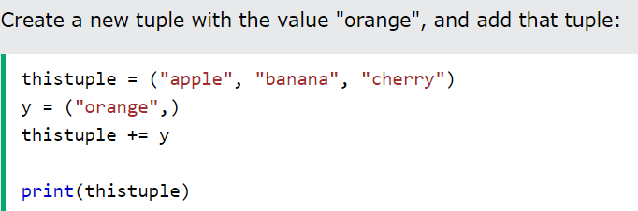
2. Add tuple to a tuple.
You are allowed to add tuples to tuples, so if you want to add one item, (or many), create a new tuple with the item(s), and add it to the existing tuple:

Slide 12
Remove Items
Note: You cannot remove items in a tuple.
Tuples are unchangeable, so you cannot remove items from it, but you can use the same workaround as we used for changing and adding tuple items:
Example
Convert the tuple into a list, remove "apple", and convert it back into a tuple
Or you can delete the tuple completely:
Example
The del keyword can delete the tuple completely:
thistuple = ("apple", "banana", "cherry") del thistuple print(thistuple) #this will raise an error because the tuple no longer exists

Slide 13
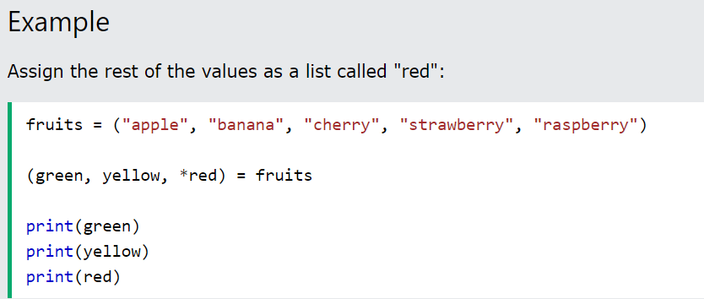
Using Asterisk*
If the number of variables is less than the number of values, you can add an * to the variable name and the values will be assigned to the variable as a list:

Slide 14
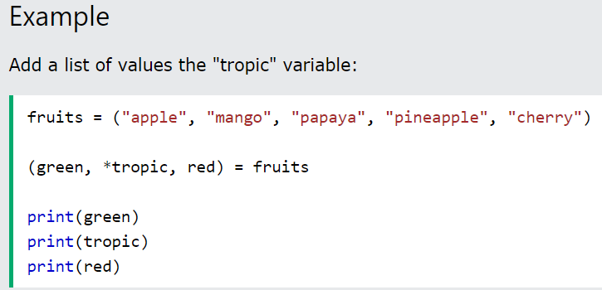
If the asterisk is added to another variable name than the last, Python will assign values to the variable until the number of values left matches the number of variables left.

Slide 15
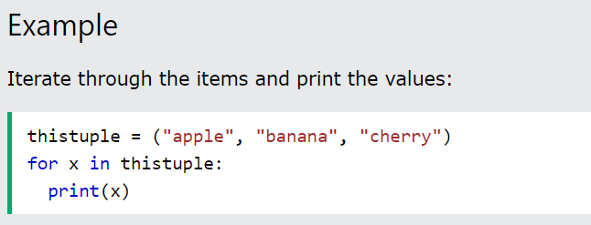
Python - Loop Tuples
Loop Through a Tuple
You can loop through the tuple items by using a for loop

Slide 16
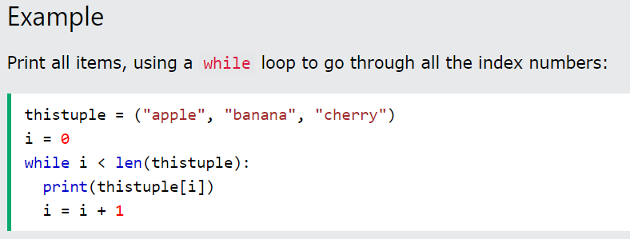
Using a While Loop
You can loop through the list items by using a while loop.
Use the len() function to determine the length of the tuple, then start at 0 and loop your way through the tuple items by refering to their indexes.
Remember to increase the index by 1 after each iteration.

Slide 17
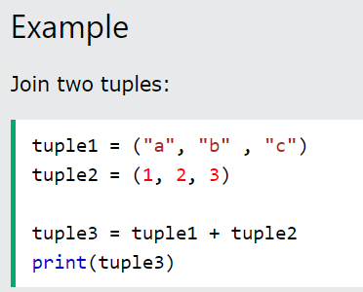
Join Two Tuples
To join two or more tuples you can use the + operator:

Slide 18
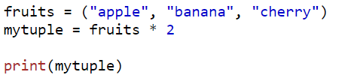
Multiply Tuples
If you want to multiply the content of a tuple a given number of times, you can use the * operator:

Slide 19
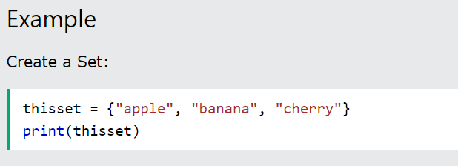
Python Sets
Set
Sets are used to store multiple items in a single variable.
Set is one of 4 built-in data types in Python used to store collections of data, the other 3 are List, Tuple, and Dictionary, all with different qualities and usage.
A set is a collection which is unordered, unchangeable*, and unindexed.
* Note: Set items are unchangeable, but you can remove items and add new items.
Sets are written with curly brackets.

Slide 20
Duplicates Not Allowed
Sets cannot have two items with the same value.
Example
Duplicate values will be ignored:
thisset = {"apple", "banana", "cherry", "apple"} print(thisset)
Get the Length of a Set
To determine how many items a set has, use the len() method.
Set Items - Data Types
Set items can be of any data type:
A set can contain different data types:

Slide 21
Access Items
You cannot access items in a set by referring to an index or a key.
But you can loop through the set items using a for loop, or ask if a specified value is present in a set, by using the in keyword.
Example
Loop through the set, and print the values:
thisset = {"apple", "banana", "cherry"} for x in thisset: print(x)
Change Items
Once a set is created, you cannot change its items, but you can add new items.

Slide 22
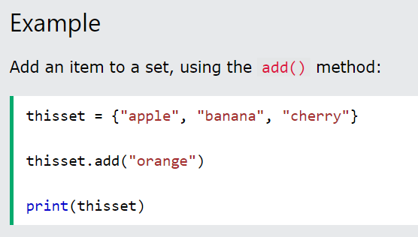
Add Items
Once a set is created, you cannot change its items, but you can add new items.
To add one item to a set use the add() method.

Slide 23
Python - Remove Set Items
Remove Item
To remove an item in a set, use the remove(), or the discard() method.
Note: If the item to remove does not exist, remove() will raise an error.
Note: If the item to remove does not exist, discard() will NOT raise an error.
You can also use the pop() method to remove an item, but this method will remove the last item. Remember that sets are unordered, so you will not know what item that gets removed.
The return value of the pop() method is the removed item.

Slide 24
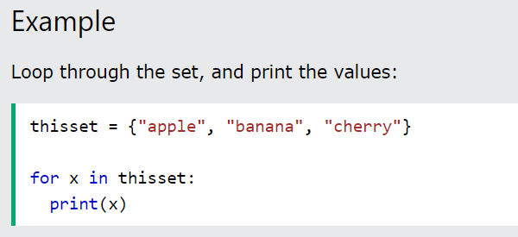
Loop Items
You can loop through the set items by using a for loop:

Slide 25
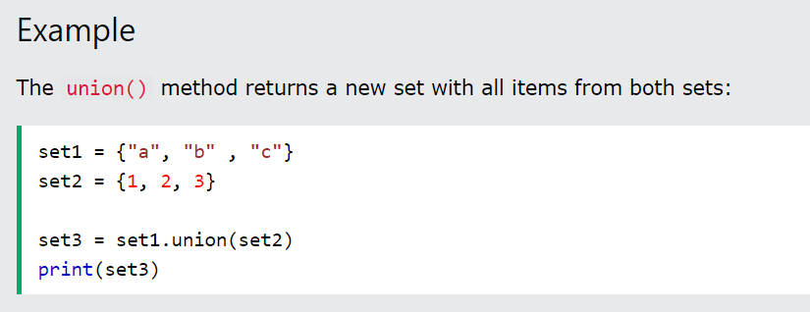
Join Two Sets
There are several ways to join two or more sets in Python.
You can use the union() method that returns a new set containing all items from both sets, or the update() method that inserts all the items from one set into another:
Note: Both union() and update() will exclude any duplicate items.

Slide 26
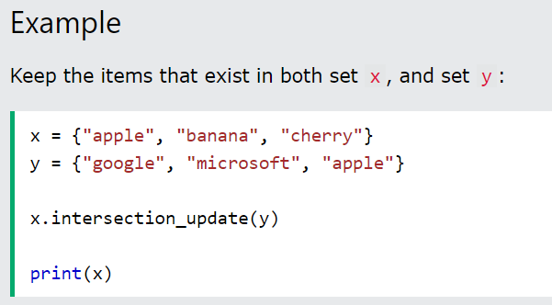
Keep ONLY the Duplicates
The intersection_update() method will keep only the items that are present in both sets.
The intersection() method will return a new set, that only contains the items that are present in both sets.

Slide 27
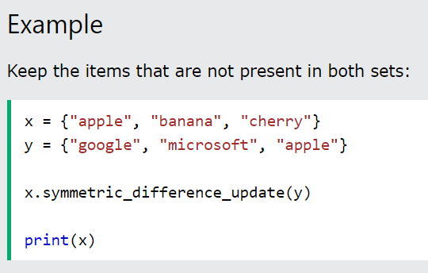
Keep All, But NOT the Duplicates
The symmetric_difference_update() method will keep only the elements that are NOT present in both sets.

Slide 28
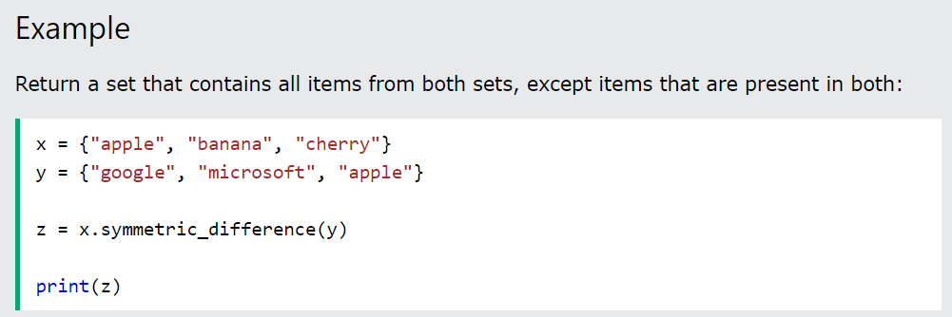
The symmetric_difference() method will return a new set, that contains only the elements that are NOT present in both sets.

Slide 29
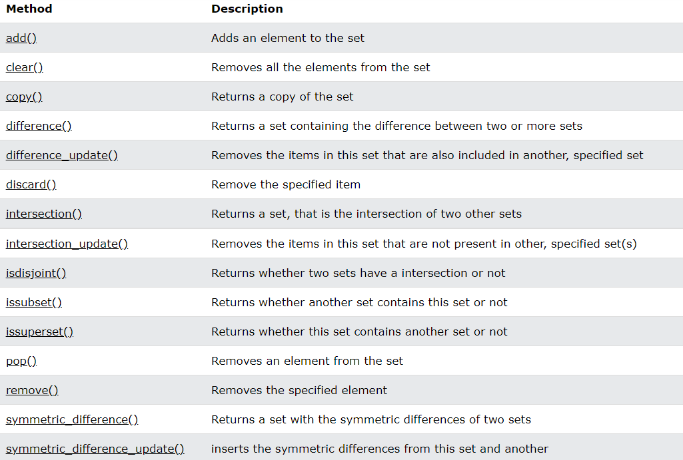
Set Methods

Slide 30
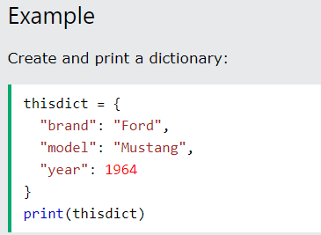
Python Dictionaries
Dictionary
Dictionaries are used to store data values in key:value pairs.
A dictionary is a collection which is ordered*, changeable and does not allow duplicates.
As of Python version 3.7, dictionaries are ordered. In Python 3.6 and earlier, dictionaries are unordered.
Dictionaries are written with curly brackets, and have keys and values:

Slide 31
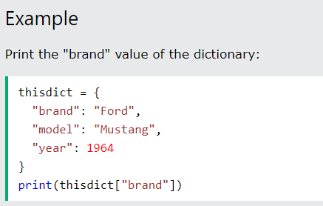
Dictionary Items
Dictionary items are ordered, changeable, and does not allow duplicates.
Dictionary items are presented in key:value pairs, and can be referred to by using the key name.

Slide 32
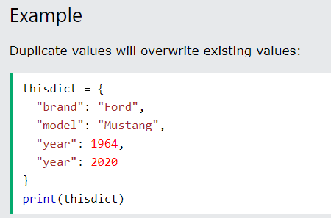
Changeable
Dictionaries are changeable, meaning that we can change, add or remove items after the dictionary has been created.
Duplicates Not Allowed
Dictionaries cannot have two items with the same key:

Slide 33
Dictionary Length
To determine how many items a dictionary has, use the len() function
Dictionary Items - Data Types
The values in dictionary items can be of any data type:

Slide 34
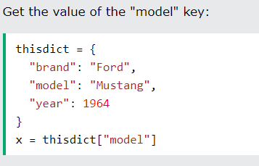
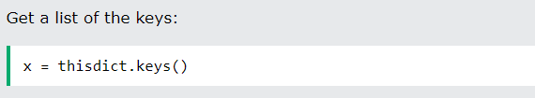
Python - Access Dictionary Items
Accessing Items
You can access the items of a dictionary by referring to its key name, inside square brackets:
Example
Get Keys
The keys() method will return a list of all the keys in the dictionary.
Example

Slide 35
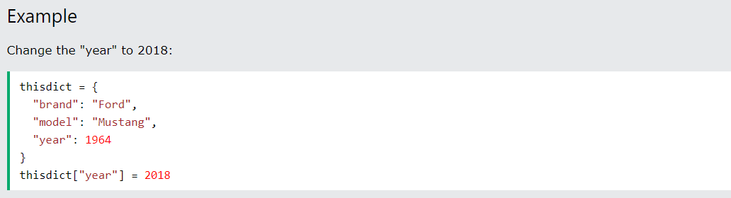
Change Values
You can change the value of a specific item by referring to its key name:
Update Dictionary
The update() method will update the dictionary with the items from the given argument.
The argument must be a dictionary, or an iterable object with key:value pairs.

Slide 36
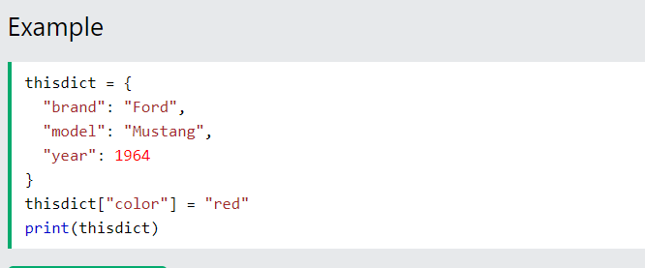
Python - Add Dictionary Items
❮ Previ
Adding Items
Adding an item to the dictionary is done by using a new index key and assigning a value to it:

Slide 37
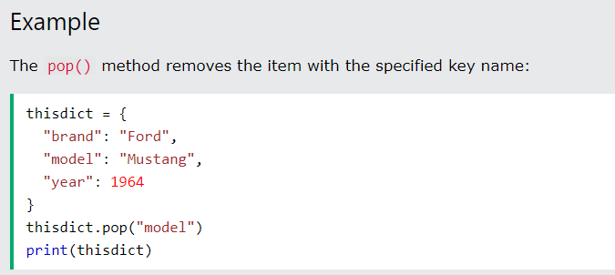
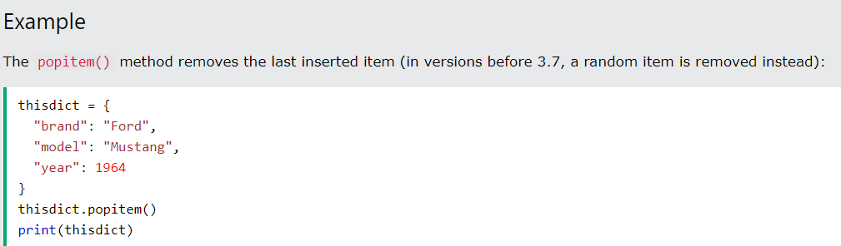
Python - Remove Dictionary Items
Removing Items
There are several methods to remove items from a dictionary:
Example
The pop() method removes the item with the specified key name:

Slide 38
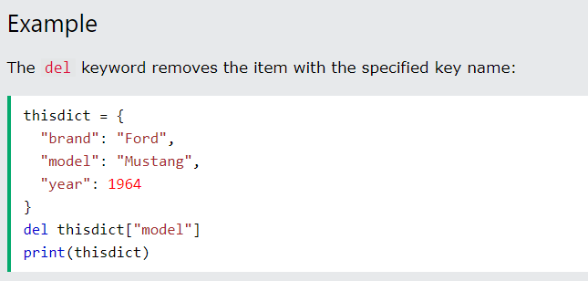
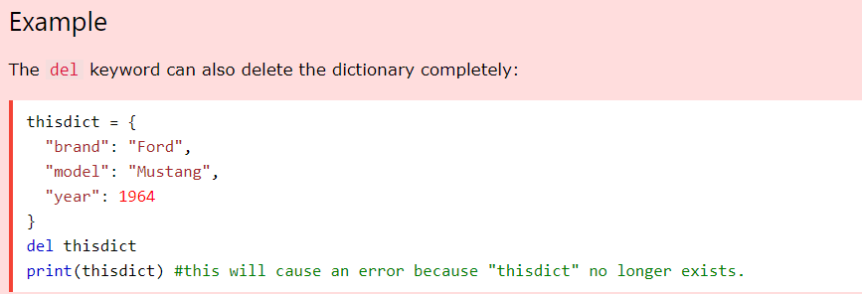

Slide 39
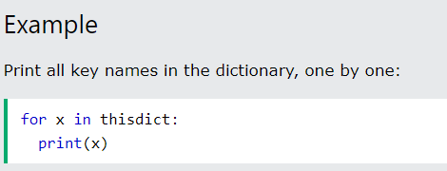
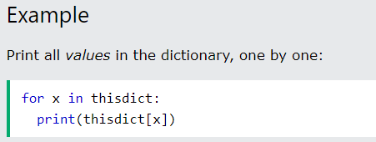
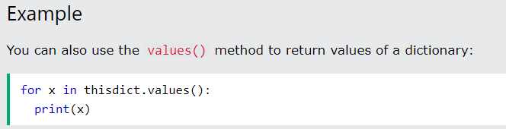
Loop Through a Dictionary
You can loop through a dictionary by using a for loop.
When looping through a dictionary, the return value are the keys of the dictionary, but there are methods to return the values as well.

Slide 40
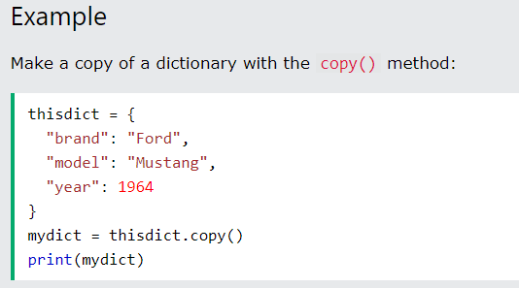
Copy a Dictionary
You cannot copy a dictionary simply by typing dict2 = dict1, because: dict2 will only be a reference to dict1, and changes made in dict1 will automatically also be made in dict2.
There are ways to make a copy, one way is to use the built-in Dictionary method copy()

Slide 41
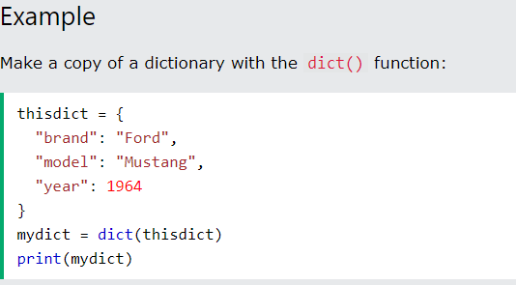
Another way to make a copy is to use the built-in function dict().

Slide 42
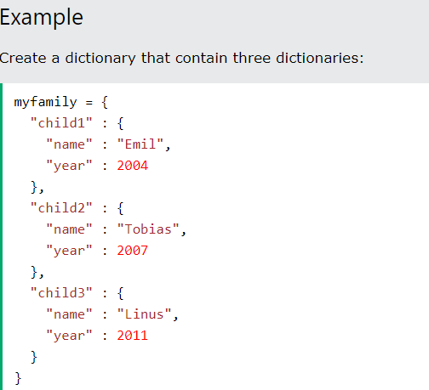
Python - Nested Dictionaries
❮ PrevioNext ❯
Nested Dictionaries
A dictionary can contain dictionaries, this is called nested dictionaries.

Slide 43
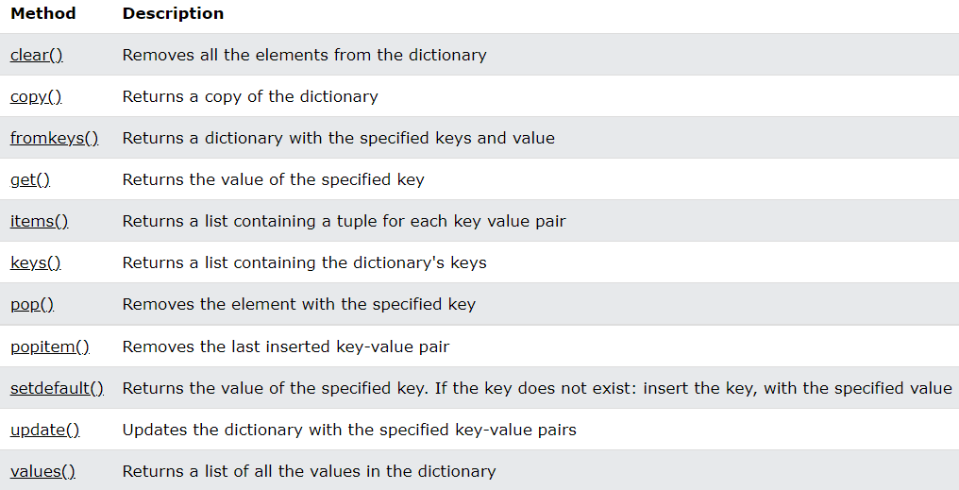
Dictionary Methods
Python has a set of built-in methods that you can use on dictionaries.

Slide 44
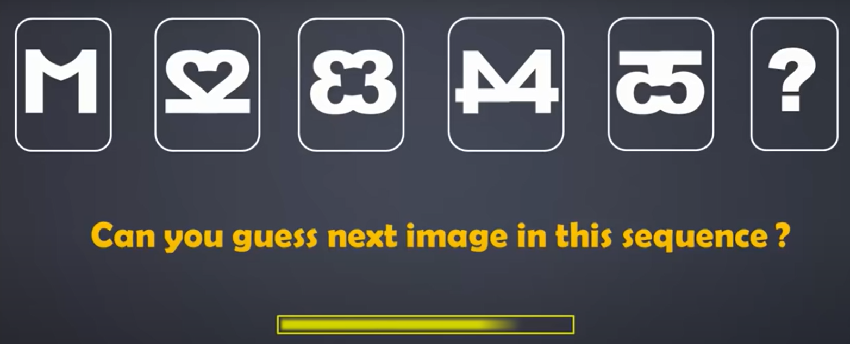
TO DEVELOP ONE’S PROGRAMMING SKILLS , ONE SHOULD FOCUS ON THEIR PROBLEM SOLVING ABILITY AND LOGICAL THINKING. RIDDLES ARE A GREAT WAY TO AID BOTH THESE SKILLS
TRY SOLVING THIS!

Slide 45
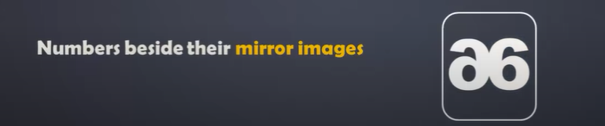
SOLUTION :

